Slide 1

Scientix, the community for science education in Europe
Notes:
1

Slide 2

http://scientix.eu
Notes:
2

Slide 3
ВЛИЯНИЕ НА ЕВРОПЕЙСКИТЕ ПРОЕКТИ ЗА УСЪВЪРШЕНСТВАНЕ НА ИЗСЛЕДОВАТЕЛСКИТЕ ПОДХОДИ

Slide 4

За 2017 г. SCIENTIX е един от 100-те най-добри световни проекта

Slide 5
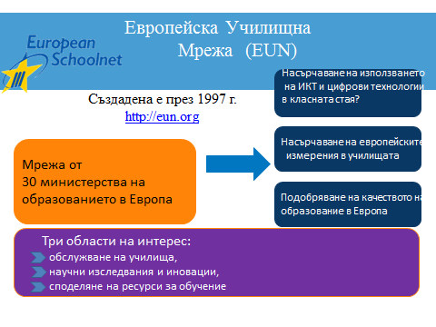
Европейската Училищна Мрежа (EUN) e неправителствена организация

Slide 6
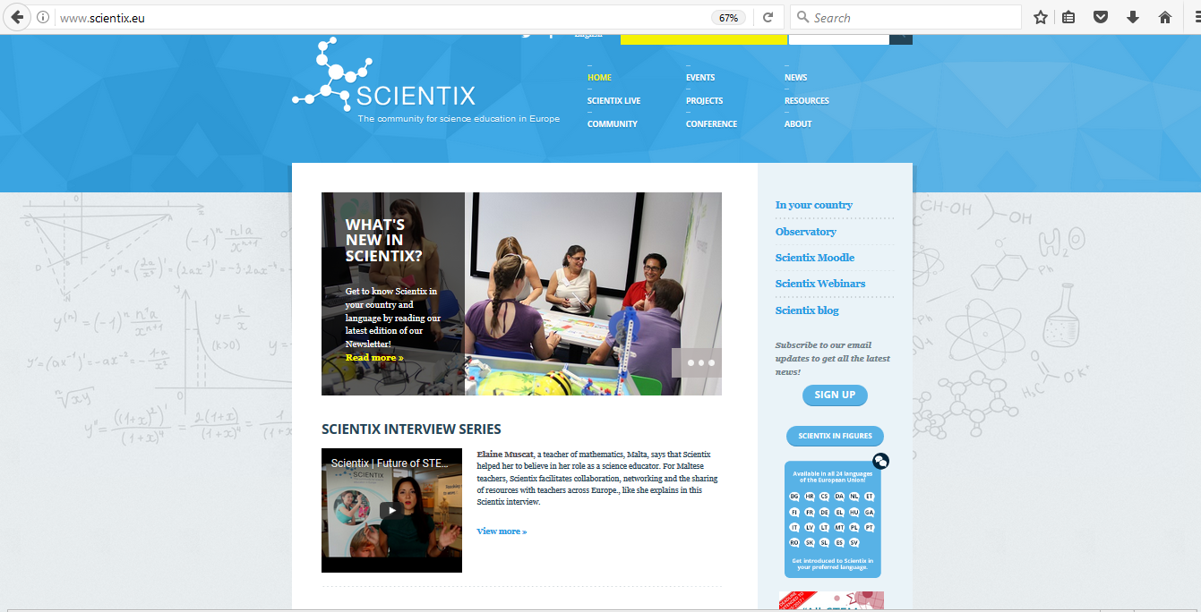
Scientix : www.scientix.eu
Scientix проекта стартира 2009 г.

Slide 7
Scientix предлага:
Ресурсно хранилище
Превод по поискване
Онлине общуване
Новини и събития

Slide 8
SCIENTIX ОБЩНОСТ
STEM СПЕЦИАЛИСТИ
STEM УЧИТЕЛ
SCIENTIX ОБЩНОСТ
ИЗСЛЕДОВАТЕЛИ
SCIENTIX НАЦИОНАЛНИ КОНТАКТНИ ТОЧКИ И ПОСЛАНИЦИ

Slide 9
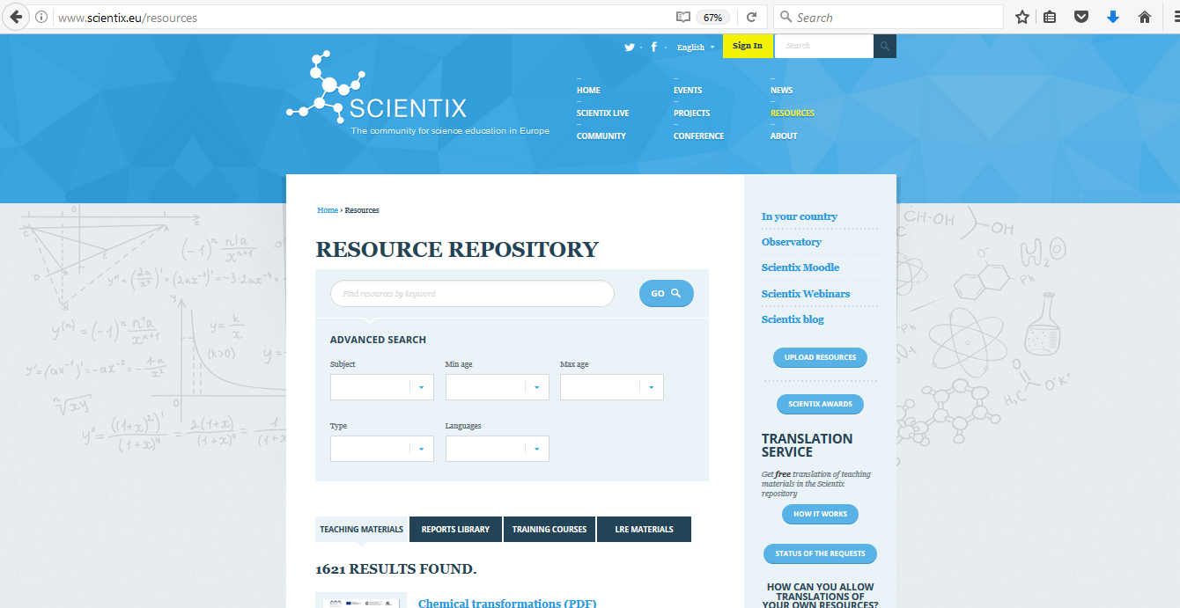
SCIENTIX РЕСУРСИ

Slide 10
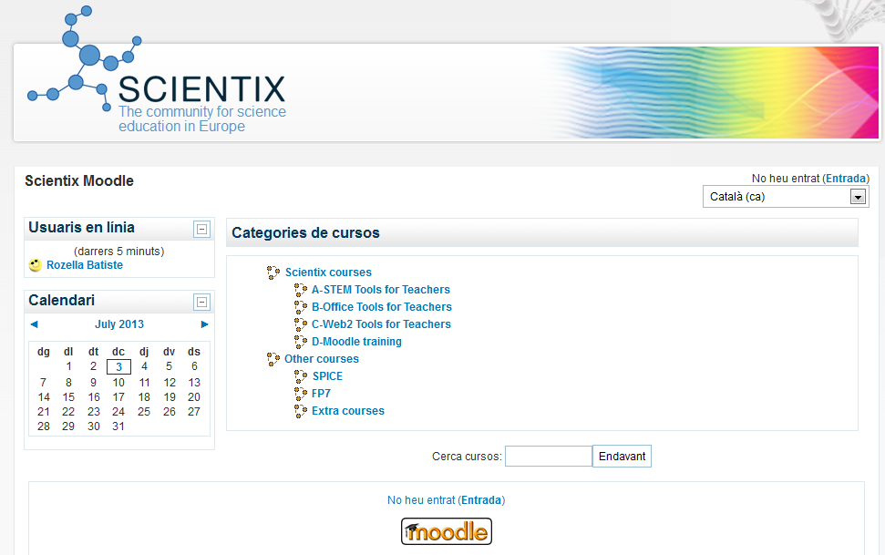
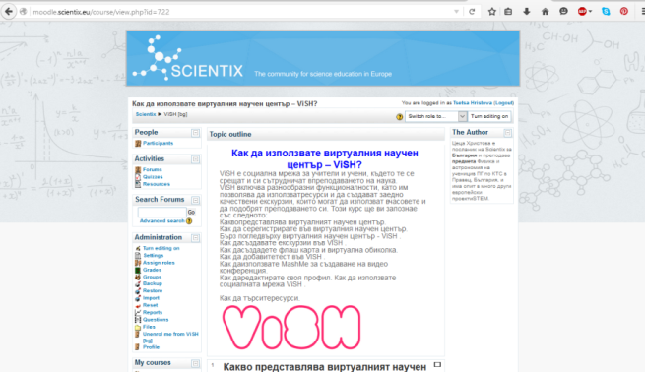

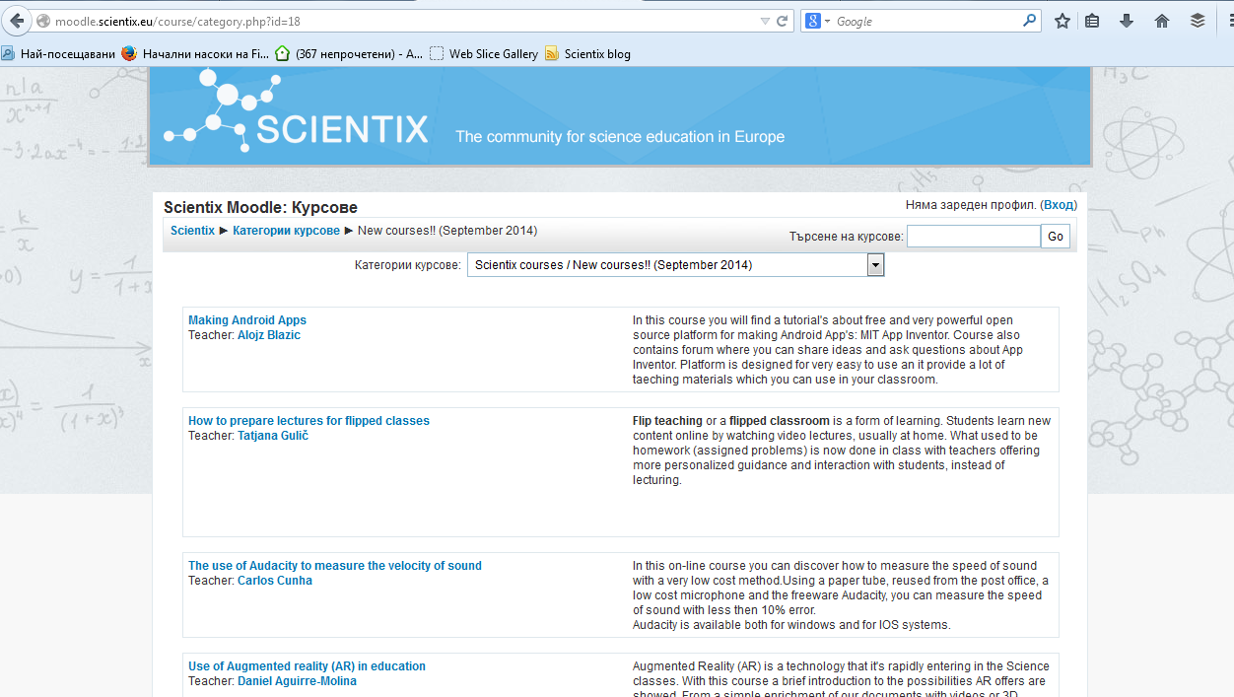
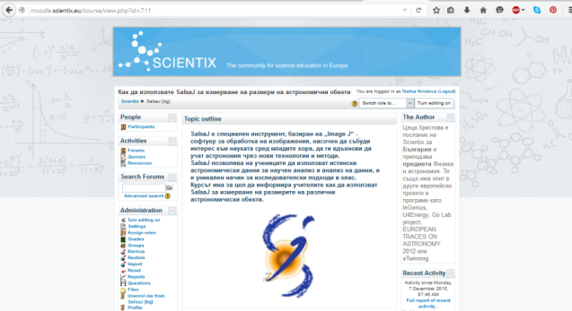
Онлайне обучение…
http://moodle.scientix.eu/course/category.php?id=18
http://moodle.scientix.eu/course/view.php?id=722
http://moodle.scientix.eu/course/view.php?id=711

Slide 11
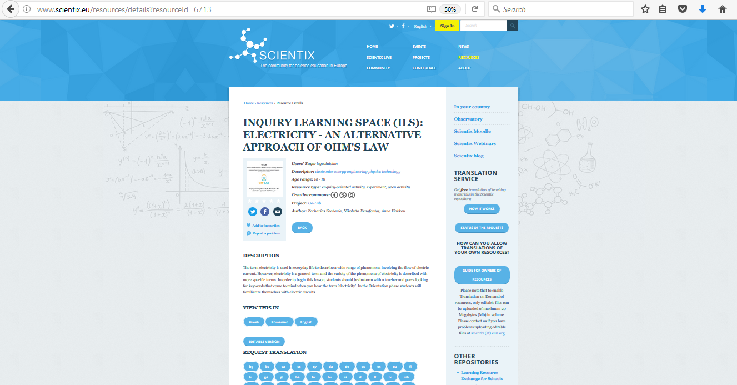
Искане на превод на ресурс

Slide 12
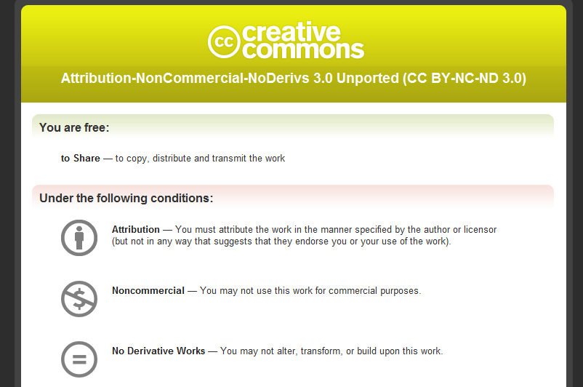
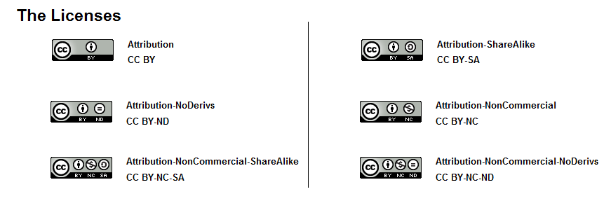
Преводи по поръчка
✓
✓
✗
✓
✓
✗

Slide 13
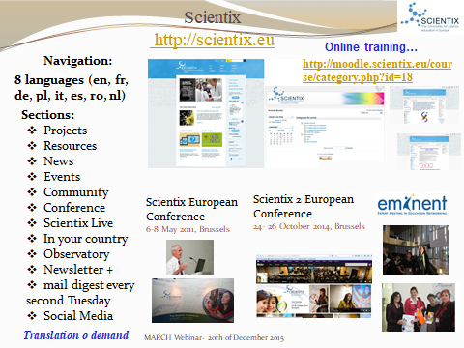

Slide 14
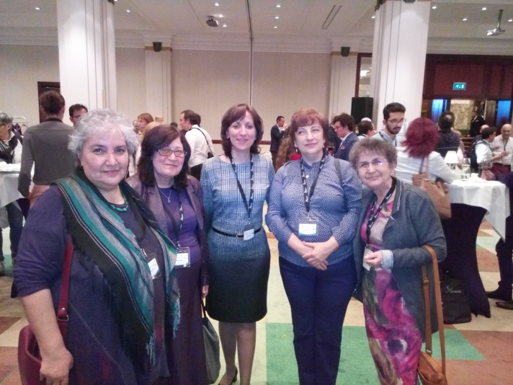
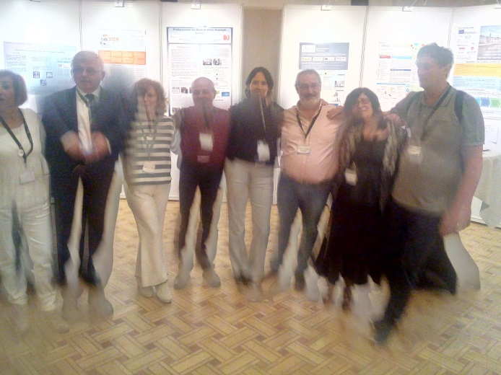
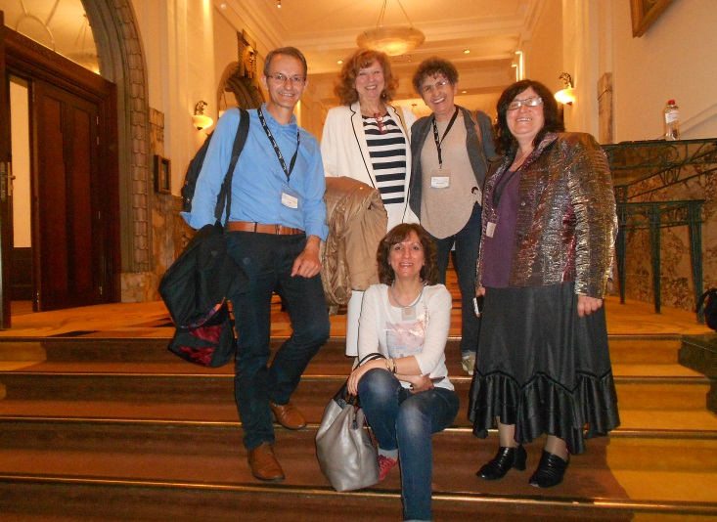
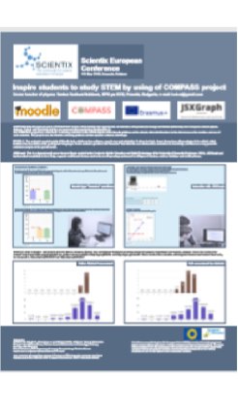
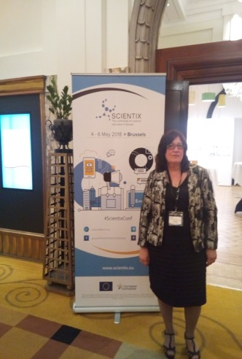
3rd Scientix Conference: 4-6 Май 2018

Slide 15
SCIENTIX - линкове
PORTAL SCIENTIX
www.scientix.eu
NEWSLETTERS
www.scientix.eu/web/guest/newsletter
TWITTER
@scientix_eu
FACEBOOK
groups/ScienceTeachersEurope

Slide 16
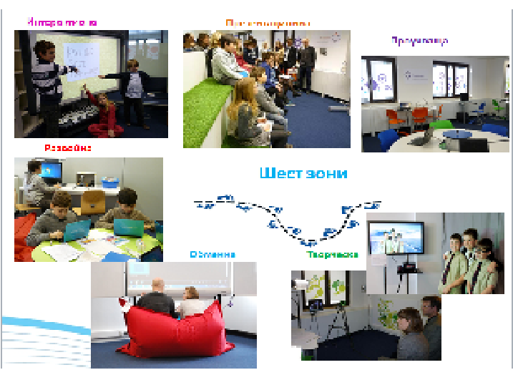
Future Classroom Lab
Шест различни зони в класната стая на бъдещето - Future Classroom Lab
http://fcl.eun.org/learning-zones

Slide 17
Future Classroom Lab
FCL workshop: Interactive technologies for the future classroom – 9.04.2018 г.
https://bit.ly/2HDVmU1
Scientix webinar: It’s a game changer! How to motivate and engage students with game-based learning – 13.04.2018 г.
https://bit.ly/2GX5JFc

Slide 18
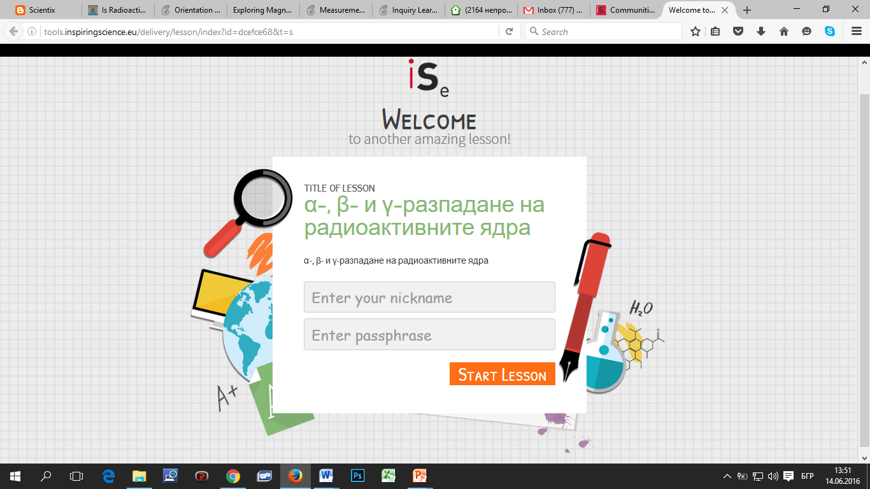
Урока за α-, β- и γ-разпадане на радиоактивните ядра

Slide 19
α-, β- и γ-разпадане на радиоактивните ядра
http://tools.inspiringscience.eu/author/app/lesson/summaryPage?id=f95bab49e0634ba5bab6ca382d58e5ef
Teacher Link
http://tools.inspiringscience.eu/delivery/lesson/index?id=7a042261&t=t&username=Tsetsa&email=ceca_hr@abv.bg
Class Link
http://tools.inspiringscience.eu/delivery/lesson/index?id=dcefce68&t=s

Slide 20
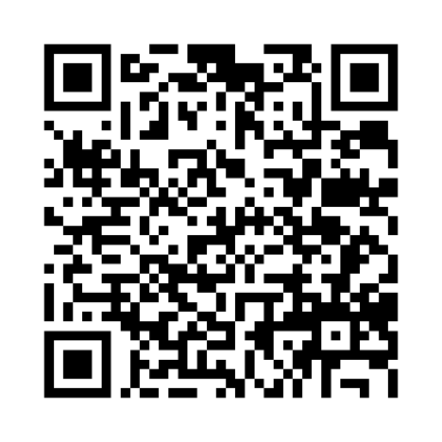
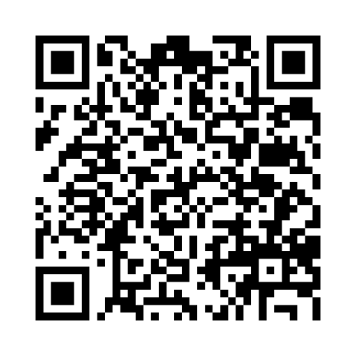
Използване на QR кода
The power of electromagnetism
Is Radioactivity always harmful for humans?

Slide 21
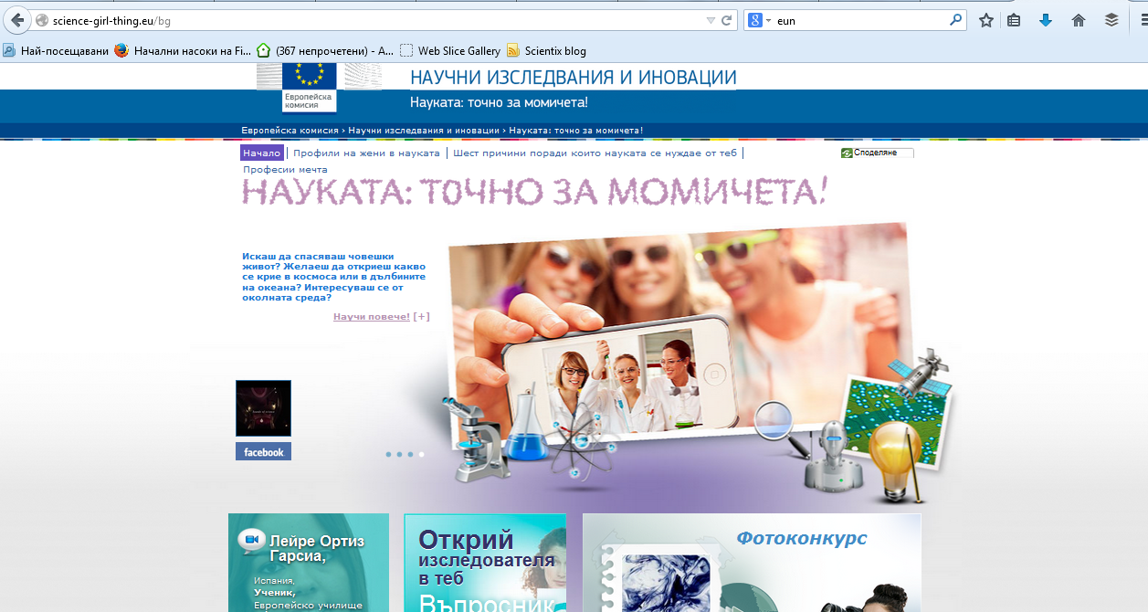
Science: it's a girl thing! http://www.scientix.eu/web/guest/science-girl-thing

Slide 22
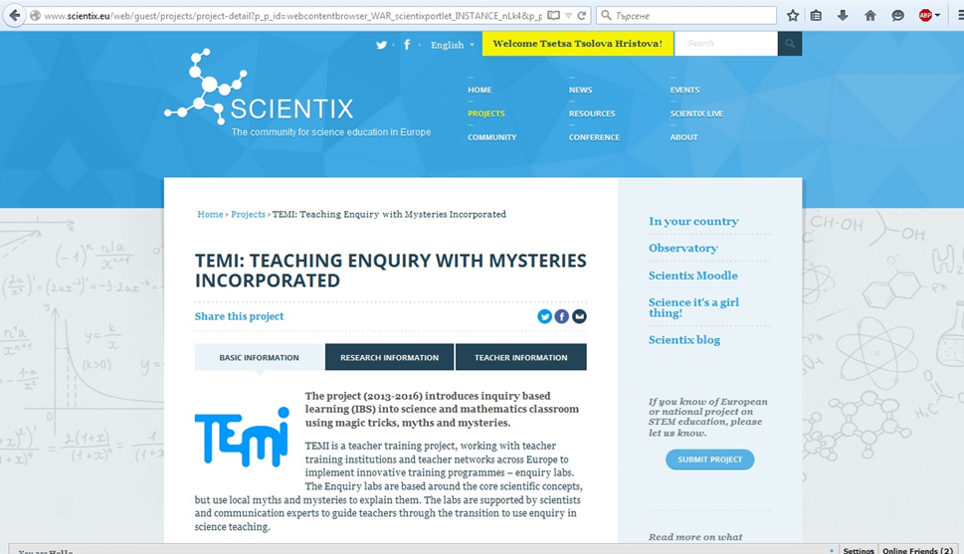
TEMI: Teaching Enquiry with Mysteries Incorporated
Учениците могат да научат повече, получавайки неочаквани резултати. Идеи за магията в науката може да открием в проекта TEMI с магически трикове, митове и мистерии.

Slide 23
Ресурси на проекта InGenius
Scrath ( http://scratch.mit.edu)
Strong truck ( http://www.strongesttruck.com
Skoool football (http://www.skoool.co.uk/1goal_skoool_football/Default.html )
Nokia Mobil Mathematics
( https://momaths.nokia.com/)

Slide 24
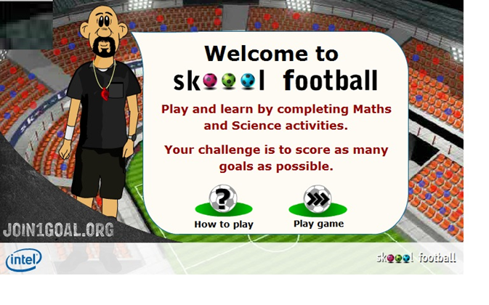
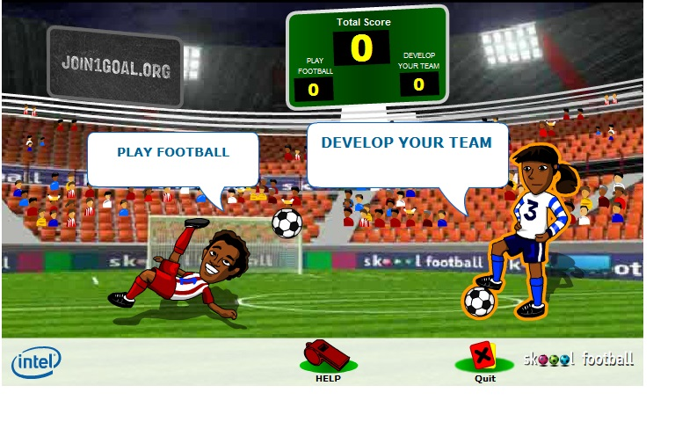
Skoool football
http://www.skoool.co.uk/1goal_skoool_football/Default.html

Slide 25
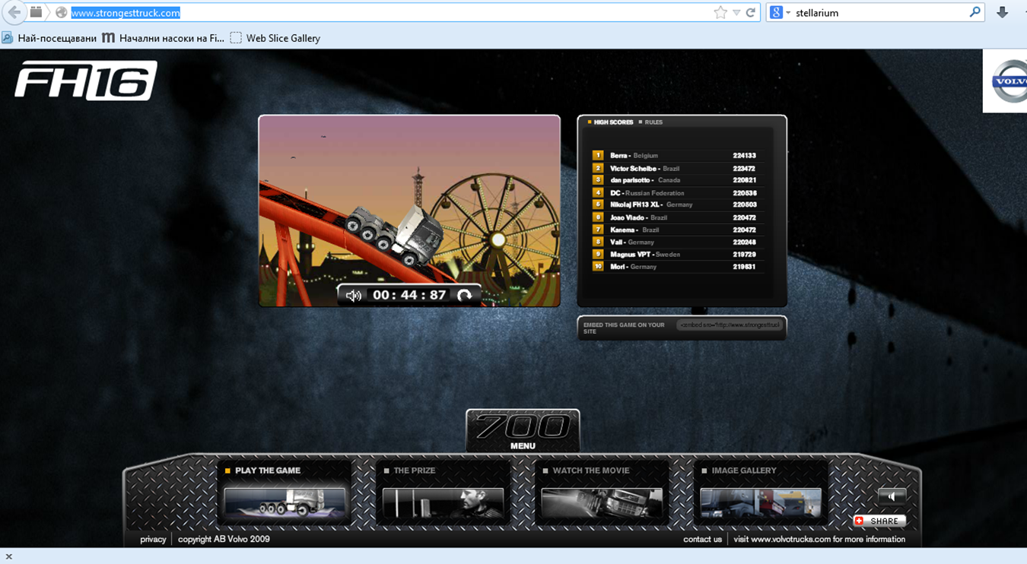
Strong truck
http://www.strongesttruck.com/

Slide 26
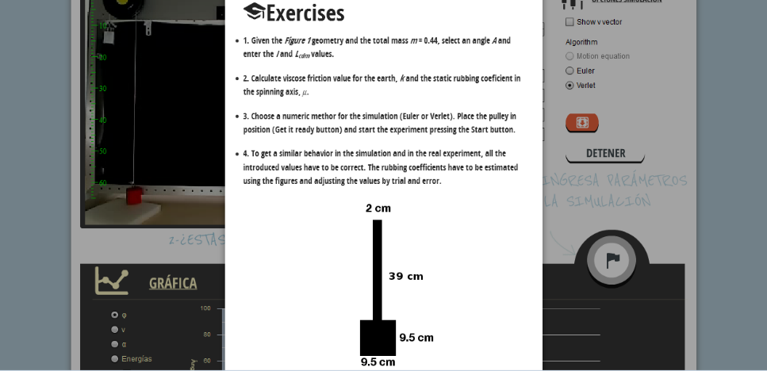
BIFI: Institute for Biocomputation and Physics of Complex Systems www.rrlab.bifi.es/pendulum

Slide 27
Online лаборатории
http://home.web.cern.ch/
http://www.donanareservas.com/entorno_en.php
http://www.projectolynx.com/ao-vivo/
http://socientize.eu/?q=pt-pt/node/382
http://cellspotting.socientize.eu
http://www.go-lab-project.eu/lab/sun4all
http://cosmoquest.org/projects/moon_mappers/
https://www.zooniverse.org/
http://boinc.berkeley.edu/projects.php
https://www.mindpaths.socientize.eu
http://rrlab.bifi.es/home

Slide 28

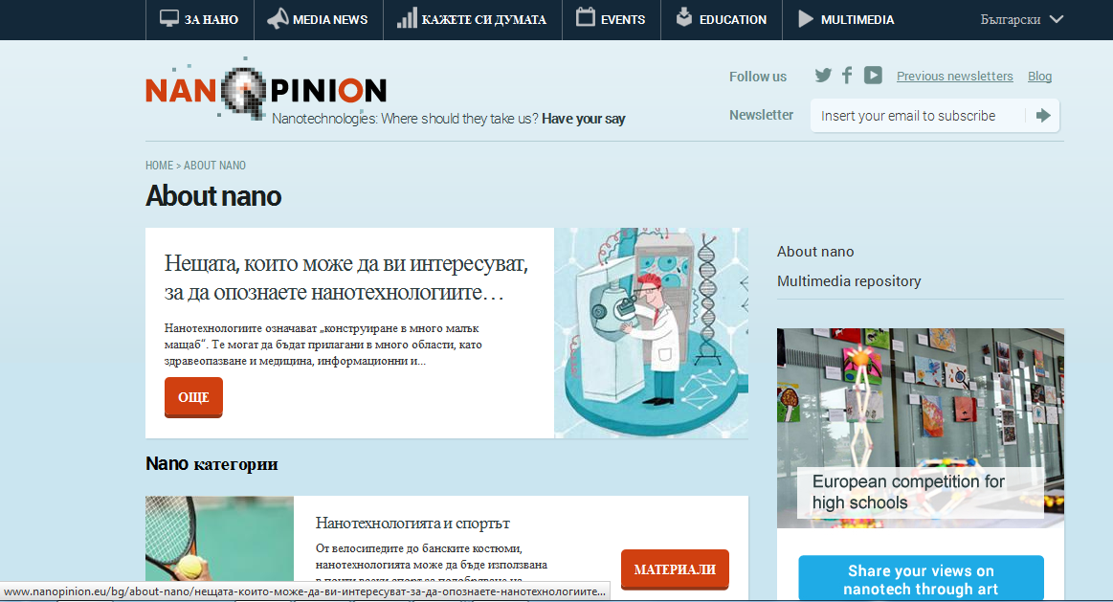
http://www.nanopinion.eu/bg/about-nano

Slide 29
STEM Alliance
http://www.stemalliance.eu/campaigns
Проектът STEM Alliance ( 2015 ) е продължение на inGenious проекта (2011-2014) и обединява образованието в областта на STEM (наука, технологии, инженерство и математика) и индустрията, министерствата на образованието.
Кампании на STEM Alliance:
STEM Discovery Week
STEM Ahead
Diversity in STEM
Инициативи:
STEM Professionals Go Back To School
Тeacher Discovery Placement

Slide 30
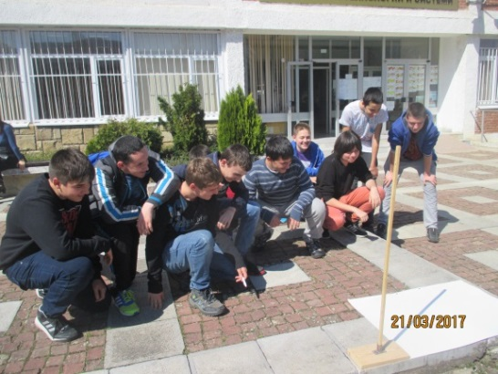
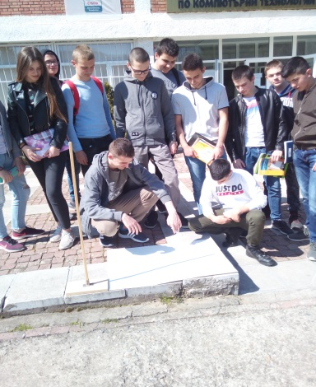
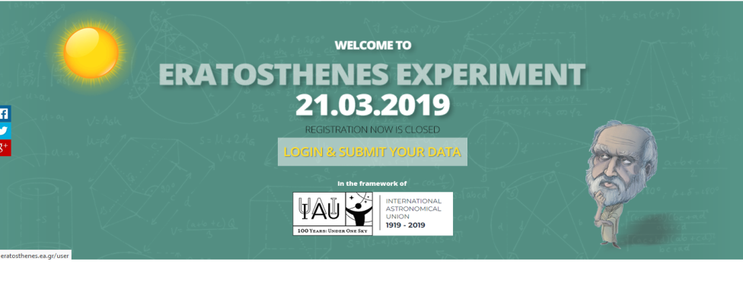
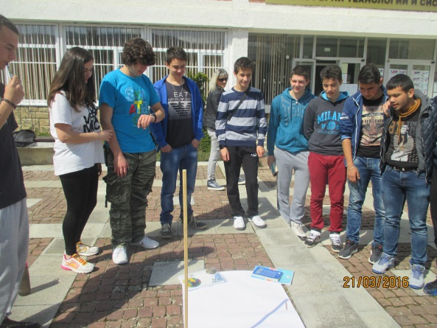
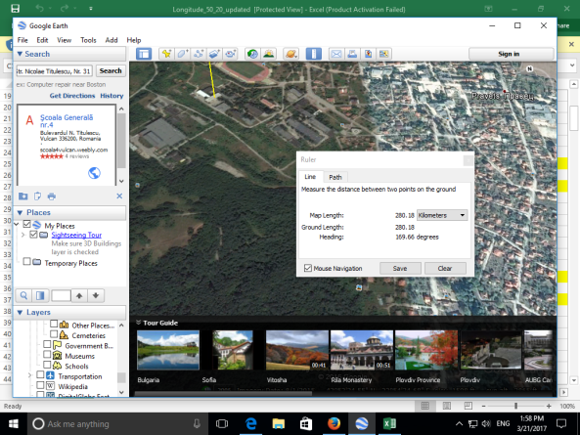
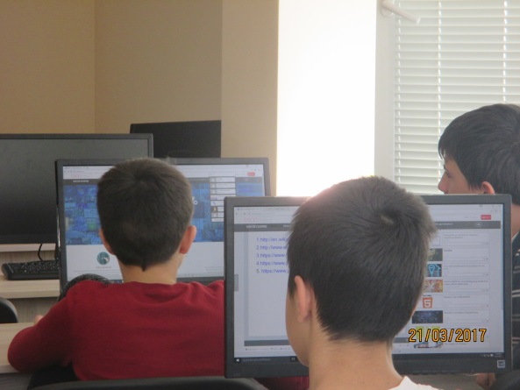
Опит на Ератостен
http://eratosthenes.ea.gr/
Измерената обиколка на Земята е:
40 729.75 km

Slide 31
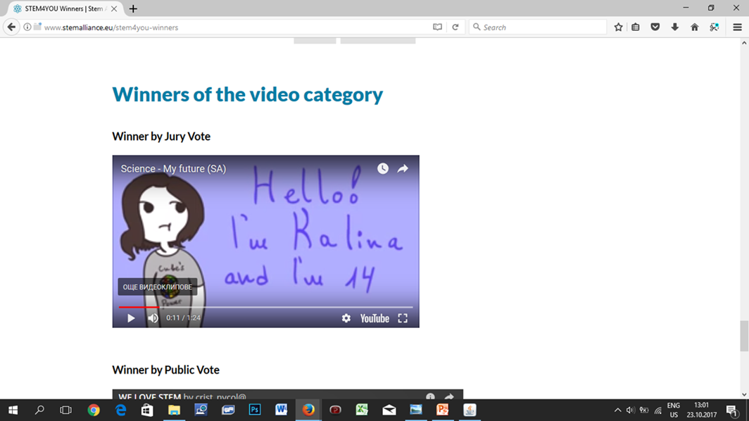
STEM4YOU Competition, STEM Discovery Week от 22 до 29 април 2016
Победител – Калина Ненова от НПГ по КТС гр. Правец, България

Slide 32
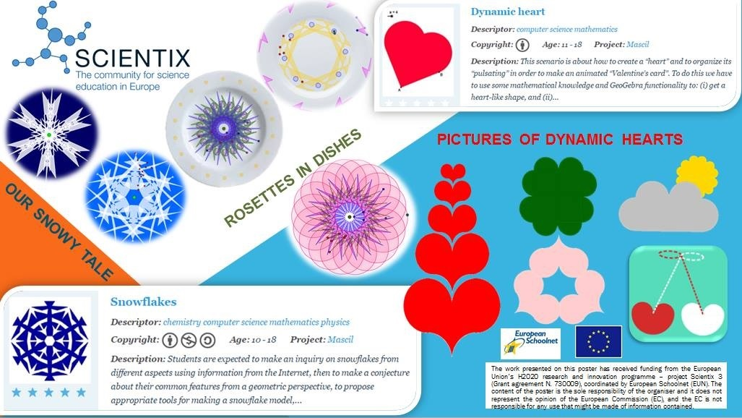
STEM Discovery Week 2017 –
победители

Slide 33
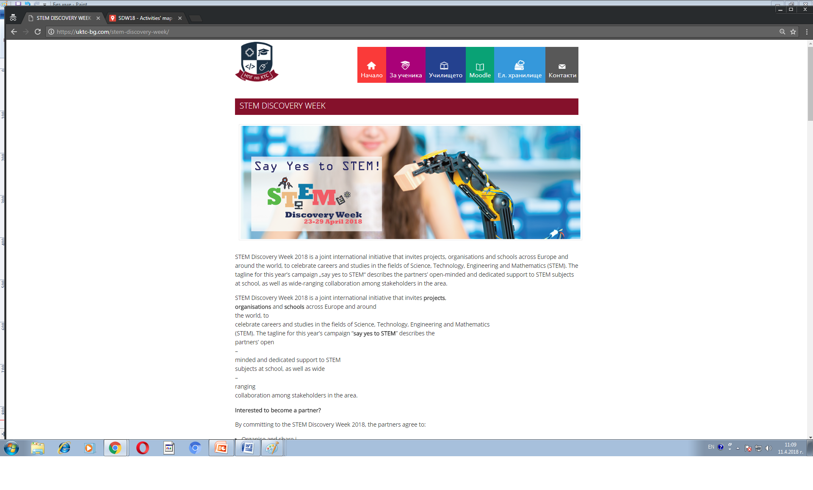
STEM Discovery Week 2018
https://uktc-bg.com/stem-discovery-week/

Slide 34
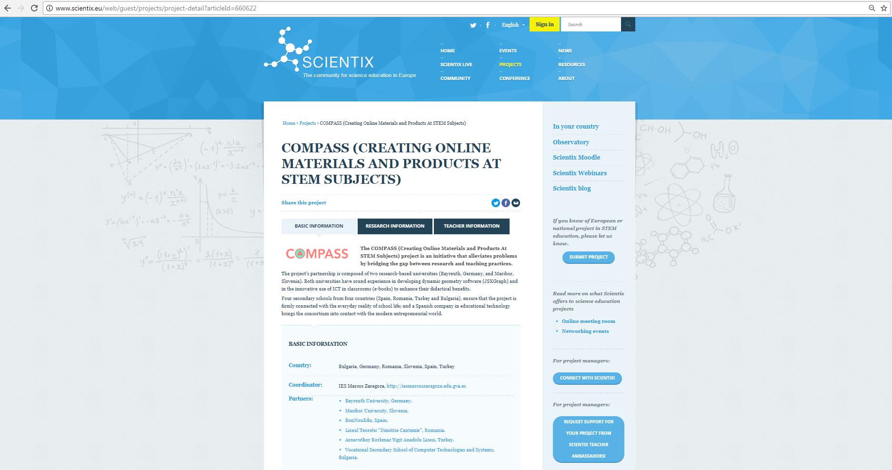
COMPASS PROJECT http://www.scientix.eu/web/guest/projects/project-detail?articleId=660622

Slide 35
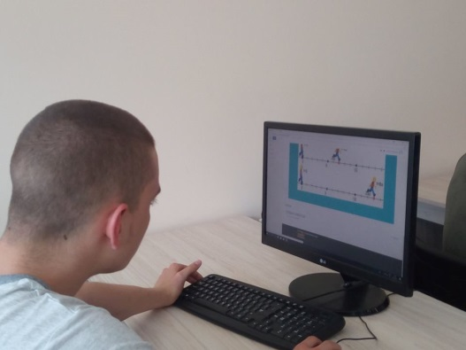
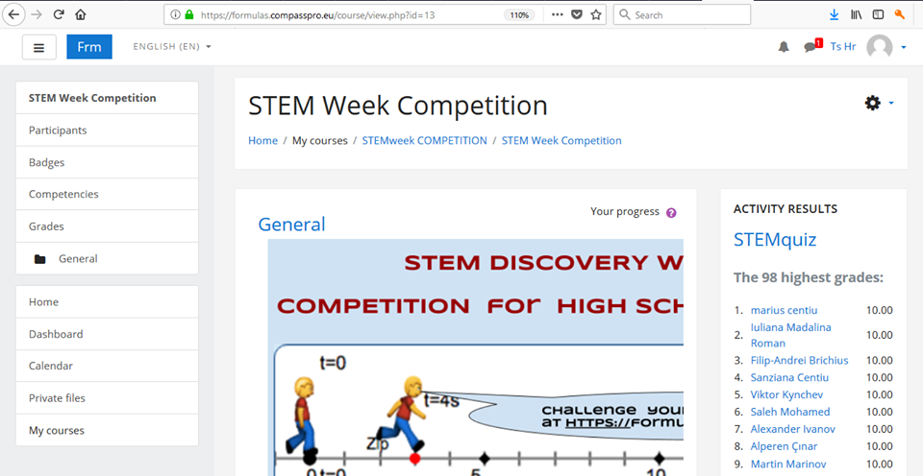
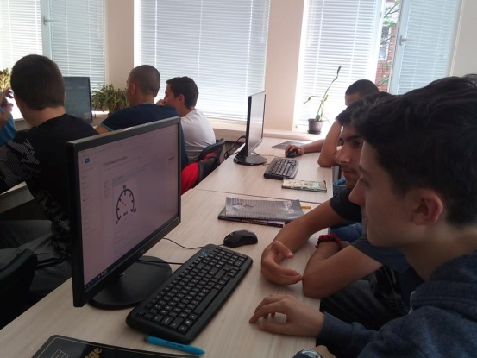
STEM Discovery WEEK 2018
Compass project competition

Slide 36
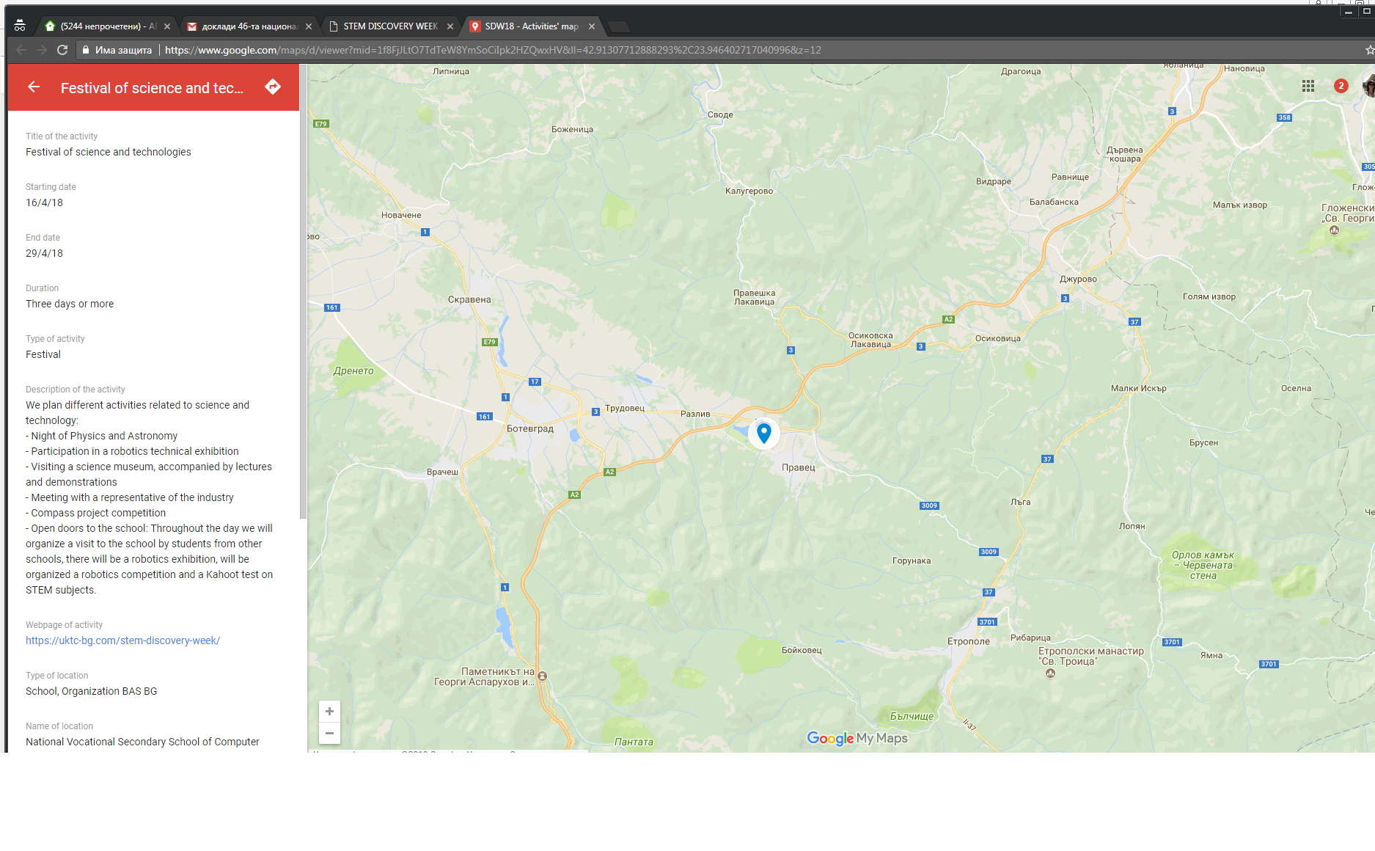
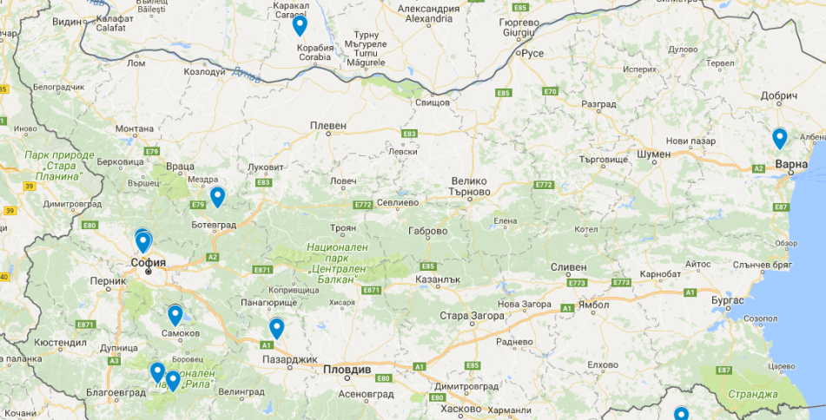
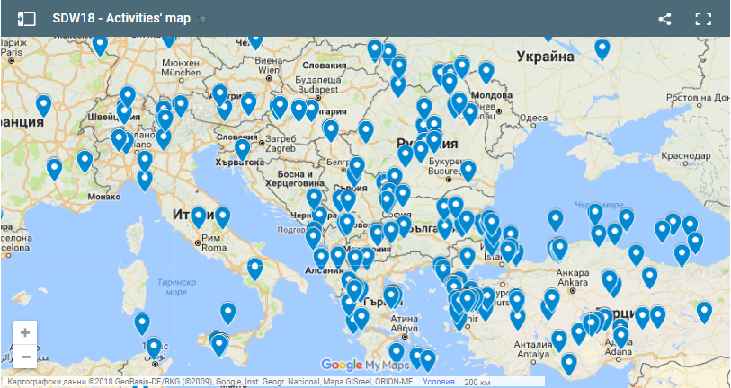
STEM Discovery Week 2018

Slide 37
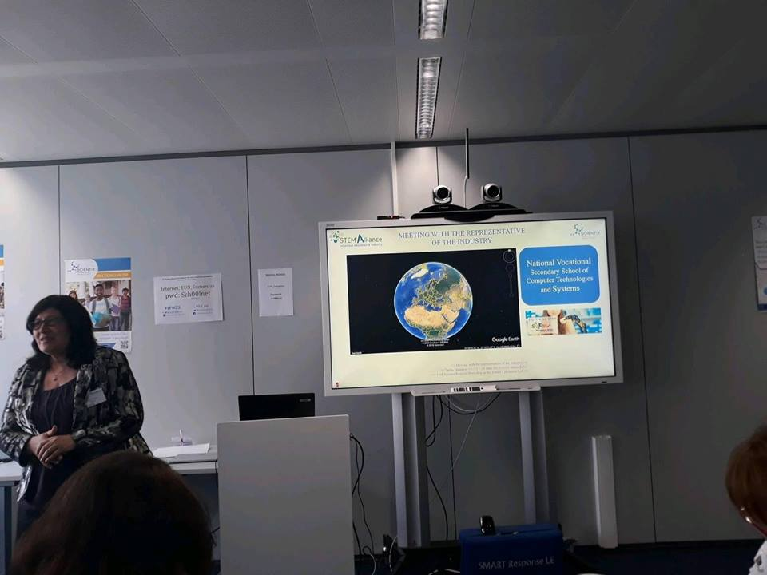
STEM Discovery Week 2018 – победители
23rd Science Projects Workshop in the Future Classroom Lab

Slide 38
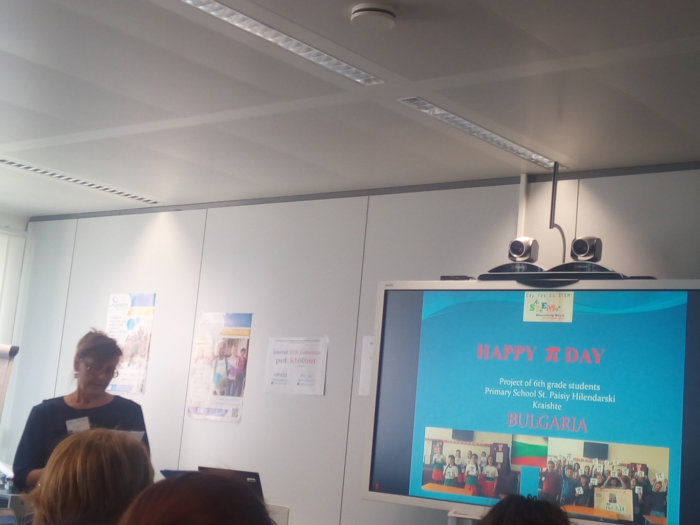
STEM Discovery Week 2018 – победители
23rd Science Projects Workshop in the Future Classroom Lab

Slide 39
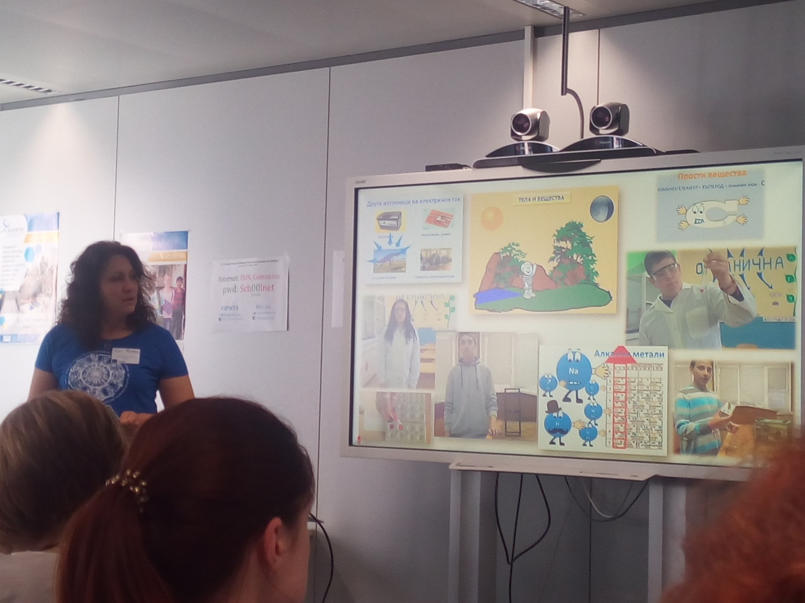
STEM Discovery Week 2018 – победители
23rd Science Projects Workshop in the Future Classroom Lab

Slide 40
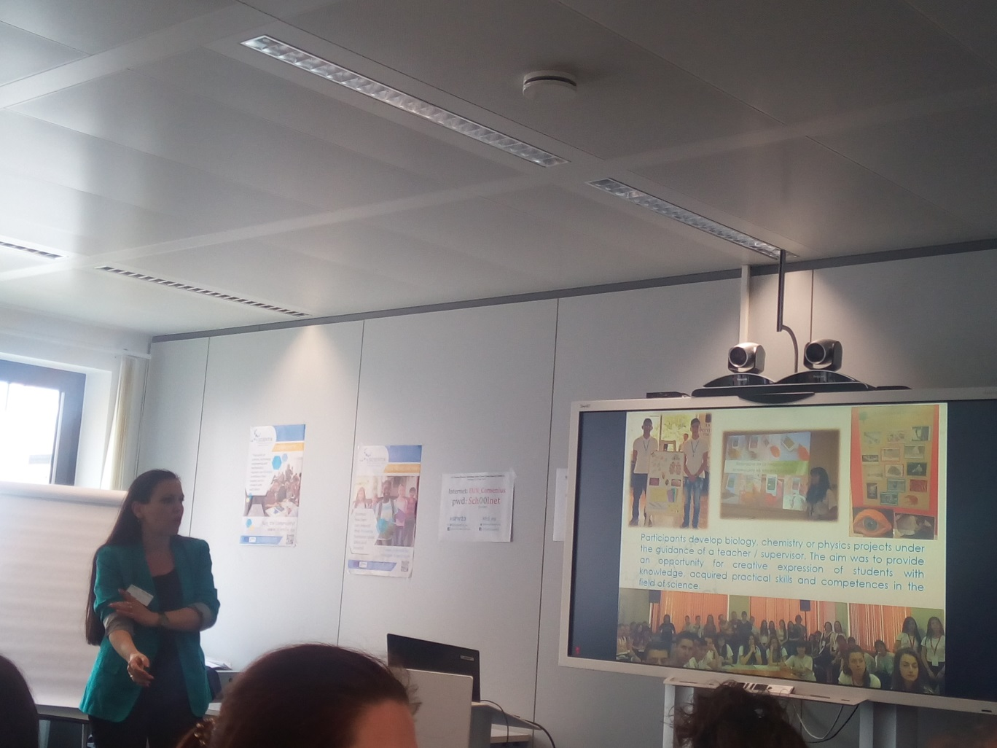
STEM Discovery Week 2018 – победители
23rd Science Projects Workshop in the Future Classroom Lab

Slide 41
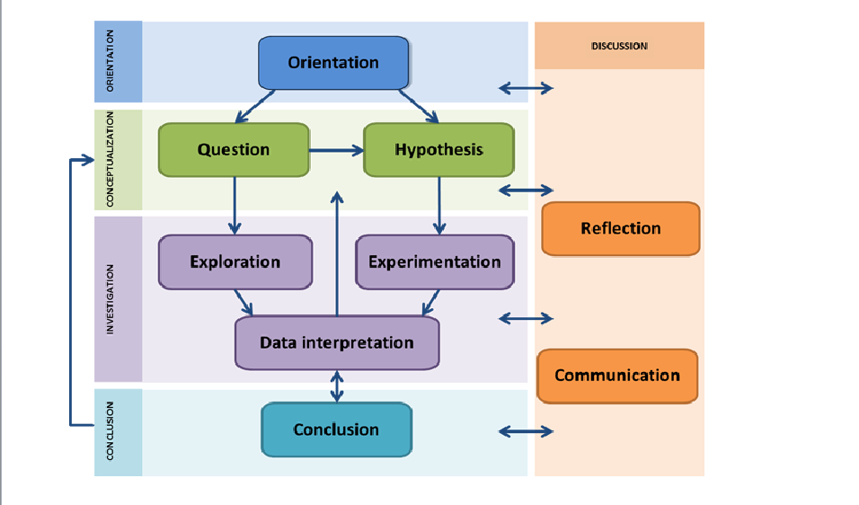
Етапи на изследователския цикъл
В Next-Lab проекта платформите за отворено авторизиране (Graasp) и споделяне (Golabz) са подобрени с нови функции и с добавянето на нови инструменти за учениците.

Slide 42
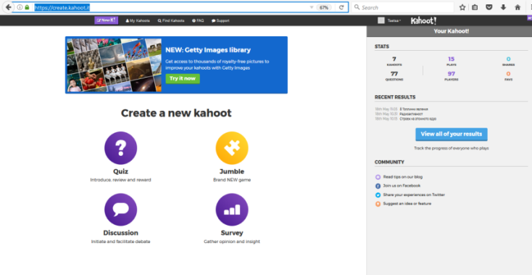
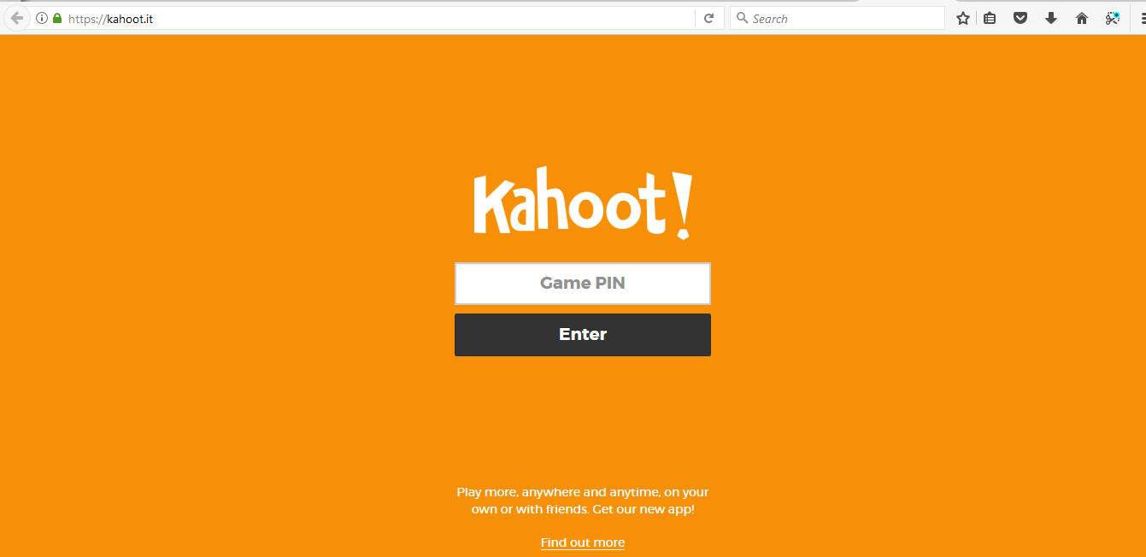

KAHOOT!: https://create.kahoot.it/
EUN and Scientix: https://play.kahoot.it/#/?quizId=ddd2e6e3-e25b-4699-8d17-cc24138249f1

Slide 43
EUN courses: http://www.europeanschoolnetacademy.eu/
2016-2017
Navigation through the Ages
Constelation: https://v.gd/luONVJ
Teaching with Space and Astronomy in your Classroom
Comparing the sizes of Solar System's astronomical objects: https://v.gd/eexK2v
Our Wonderful Universe
VISUAL MOVEMENT AND PHASES OF THE MOON: http://bit.ly/2zCPlCJ
Our Fragile Planet
Climate change and its consequences: http://bit.ly/2hrk3qG
Mentep (MENtoring Technology-Enhanced Pedagogy)
http://mentep.eun.org/about
http://mentep-sat-runner.eun.org/
Inquiry-Based Teaching in Life Sciences
https://bit.ly/2qwLVxf

Slide 44
EUN courses: https://www.europeanschoolnetacademy.eu/web/guest/courses
2018-2019
Europeana in your classroom: building 21st-century competences with digital cultural heritage
The Networked Teacher – Teaching in the 21st Century
“Yes I can” – Empowering Student Learning

Slide 45

STEM Is Everywhere!
Урок: „Let's save the planet for our children's children!“
http://bit.ly/2TUNza3

Slide 46



https://physlets.org/tracker/

Slide 47

STEM Alliance
Diversity in STEM' competition

Slide 48

https://bitly.com/

Slide 49

STEM Discovery Week 2019

Slide 50

STEM Discovery Week 2019
https://moodle.scorepro.eu/course/view.php?id=55

Slide 51



STEM Discovery Week 2019

Slide 52


I аm a mathematician
Като част от инициативата STEM Discovery Week 2019 вчера в НПГ по КТС беше проведено обучение от Maria Brauchle. Темата на workshopa беше: „I аm a mathematician“.
Учениците бяха вдъхновени да учат математика и се запознаха с някои водещи аспекти на приложната математика. Голям интерес събуди обучението за използване на специалния динамичен софтуер Geogebra. Като резултат от обучението беше направата на „Валентинка“ като пулсиращо сърце.
В резултат, инициативата се прехвърли и в часовете по математика - споделяйки своите впечатления с останалите, непринудено и спонтанно присъстващите се превърнаха в ментори по темата. Така, в часовете СИП-Математика, те с удоволствие представиха софтуера и възможностите му на своите съученици.

Slide 53


„I аm a mathematician“
Ето и някои от коментарите на учениците:
„За мен беше много полезно и с удоволствие днес ще покажа на моя клас какво съм научил. Със сигурност ще го използвам и в бъдеще.“ - Станислав Момчилов.
„Познавам Geogebra отдавна, но очевидно не достатъчно. Не знаех, че може да решава толкова сложни задачи. Освен това, накара ме да погледна решенията от друг ъгъл и да правя изводи.“ - Валери Николов.
„Не знаех, че с Geogebra мога да направя нещо толкова динамично… например сърце 😊.“ - Поля Петрова.
„Много ми хареса. Очаквам да има и следващи подобни уъркшопи.“- Александър Диков.

Slide 54
Dear Manolova Iveta, Thank you for participating in the STEM Alliance Competition during this year’s STEM Discovery Week 2019. We are delighted to inform you, that your entry “I Am a Mathematician” is one of the winners in the Events category! Thank you for your outstanding contribution. As a winner, we are glad to award you with the following: Invitation to the 30th Science Projects Workshop in the Future Classroom Lab, Brussels (June 14-16, 2019) You are cordially invited to participate in the 30th Science Projects Workshop (SPW) taking place in the Future Classroom Lab (FCL) at European Schoolnet (EUN), Brussels on 14-16 June 2019 co-organised by various STEM projects.

Slide 55




STEM SCHOOL LABEL - PROMOTIONAL PACKAGE
https://www.stemschoollabel.eu/

Slide 56

Register
https://www.stemschoollabel.eu/register
Criteria
What is a STEM School?
https://www.stemschoollabel.eu/criteria

Slide 57


Астропарти Байкал

Slide 58
Me, My Colleagues & Go-Lab (1/2) Rosa Doran
Notes:
Have you ever tried to motivate a colleague to use Go-Lab? (%)
Where you successful in convincing your colleague? (%)

Slide 59
Me, My Colleagues & Go-Lab (2/2) Rosa Doran
Reasons for success
Interest in Go-Lab
Young teachers (digital natives)
Need for using technology
New teaching approach/ methodology
Co-creation
Existing material (duplicate or “use”)
Demonstration first (show then tell)
Benefits to students
Attending training
Reasons for “unsuccess”
Don’t want to “change a winning horse”
Lack of motivation
School’s IT infrastructure
Lack of digital competencies
Time & effort to create
Complexity of the ecosystem
“Digital” is not as efficient
Other platforms and resources
Sticking to curriculum’s textbooks
Notes:
What was the reason for your success?
What was the reason for this not working?

Slide 60
Go-Lab Dissemination in my Teaching-Community Rosa Doran
Whose support would you need?
Regional authorities*,educational institutions, inspectors
Administration** / headmaster
Head of department / coordinator
Teachers resource centre
Teachers / colleagues
Trainers
*Admin and authorities support for promotion and acceptance
**Admin support in logistics; IT infrastructure (devices & WIFI), computer room scheduling…
Notes:
Whose support would you need for successful dissemination of Go-Lab in your teaching-community?

Slide 61
Encouraging Teachers to use Go-Lab Rosa Doran
What would encourage more teachers from your school/region to use Go-Lab?
Professional training, courses, webinars and support (free/ funded)
Peer-to-peer training, co-creation of curriculum specific ILSs and support
Local Go-Lab teachers’ network & Go-Lab school steering team / job shadowing
Receiving recognition for attending training and working with the ecosystem
Presentations/ demonstrations with students‘ participation
Networking events
Go-Lab affiliated funded projects at school/ region
Enriching and simplifying the ecosystem
Notes:
What would encourage more teachers from your school/region to use Go-Lab?

Slide 62
Me, My Admin & Go-Lab Rosa Doran
Reasons to adopt Go-Lab
Admin’s interest in supporting innovation with ICT
If teachers want it
It’s free
Motivating for students
All lessons and materials in one place
Reasons not to adopt Go-Lab
If teachers do not want it
Clear direct link to local curriculum missing
Teachers lack of IT skills / confidence
Insufficient IT infrastructure/ financing
Logistics /scheduling rooms
Needs time & effort to learn
Difficulty in creating new ILSs
Not seeing advantages / No need for Go-Lab
Notes:
What would be the main reason for these persons to use or not use Go-Lab?
What prevented you from doing so?

Slide 63
Instructions to use offline Inquiry Learning Spaces
https://graasp.eu/resources/5dcaceb3cb22cdfcde6e6003

Slide 64
mentimeter
https://www.mentimeter.com/
https://www.mentimeter.com/s/15bc8c7a534e366421bd2566e4306bb8/cf26b3510c75
www.menti.com
Код: 812691

Slide 65


Slide 66


Slide 67

Labs Land
https://labs.land/ppmg-botevgrad/?lang=en

Slide 68


Slide 69

Цеца Цолова Христова,
ПГ по КТС гр. Правец
Scientix посланик за България
e-mail: tzetza@gmail.com
https://www.facebook.com/tsetsa.tsolova
Twitter: @ceca_hr
http://ceca-scientix.blogspot.bg/

Slide 70
Благодаря Ви за вниманието!

